Slide 1
Health Care – Specially Abled Detection App

Slide 2
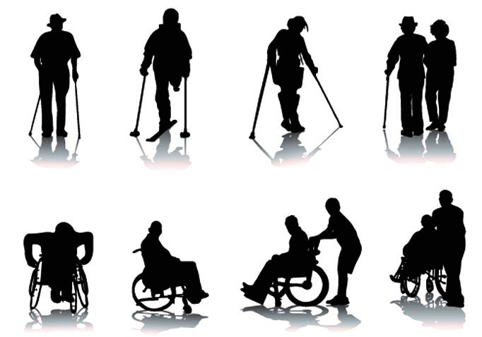

Quick Questions
What strikes your mind when you think of the term ‘disability’?

Slide 3

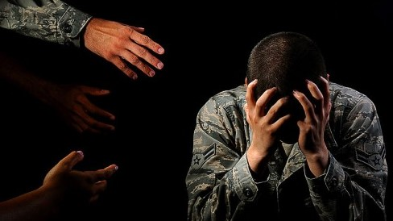
Quick Questions
Do you think you are fit? Or do you seem to be facing problems?

Slide 4
Why this App?
There are around 8 categories of disabilities as listed by Ministry of Health & Family.
These include:
Locomotive disabilities
Hearing impairments
Visual impairments
Blood related disorders
Mental Illness, etc.
PROBLEM: No system available for early detection of disabilities due to lack of coordination between medical board and social welfare department.
REQUIREMENT: We need an app which has a set of questions, by answering which early identification of disability can be done.

Slide 5
Features
Various tests to assess different kinds of disabilities.
Easy tests. Can be self assessed by answering simple questions.
Both English and Hindi languages are supported.
Some tests designed especially for ease of professionals.
Doctors from various fields are connected to our platform.
Users can seek medical help (in the form of second opinion) directly through our site.

Slide 6
Application
User can take various tests to assess their own disability.
This would enable them to take preventive or curable measures at right time.
This test being very easy and available in different languages would enable more number of users to be benefitted.
User data and details can be sent to doctors so as to get direction on further treatments.
This database can also be used for medical studies and surveys.

Slide 7
Future Development
Extending the platform for all kinds of disabilities.
Integrating feature of chat box so that user and doctor can have one on one communication.
Keeping track of medical records through Blockchain.

Slide 8
Screenshots

Slide 9
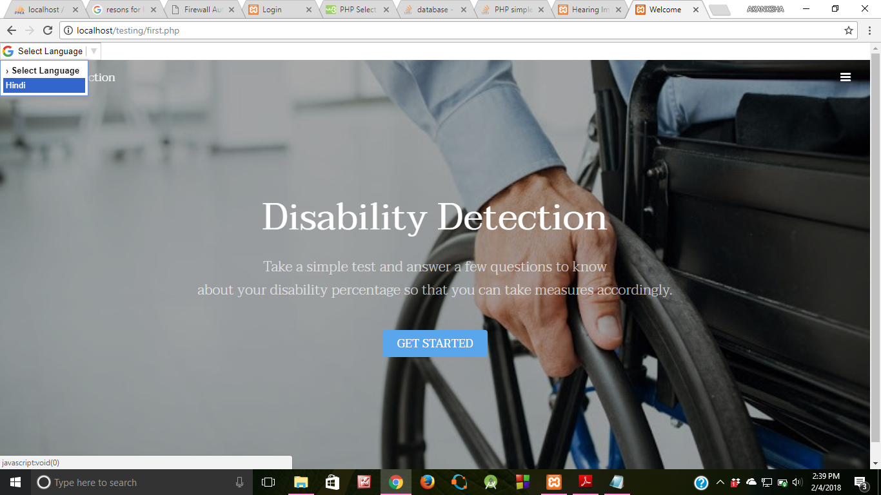

Slide 10
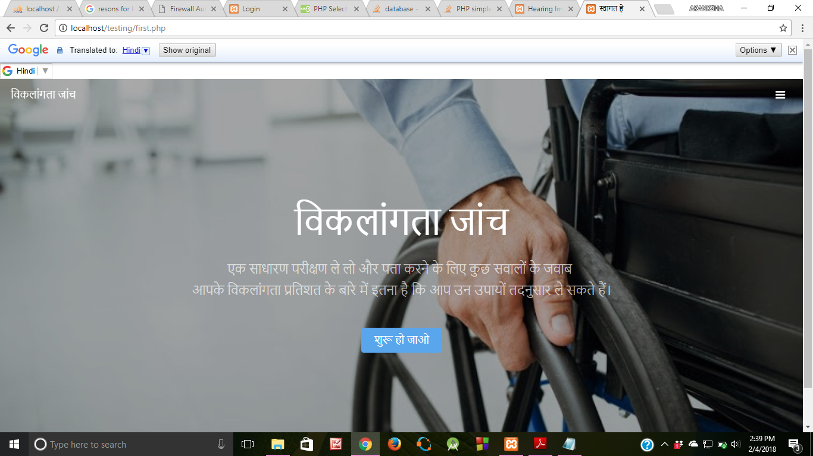

Slide 11
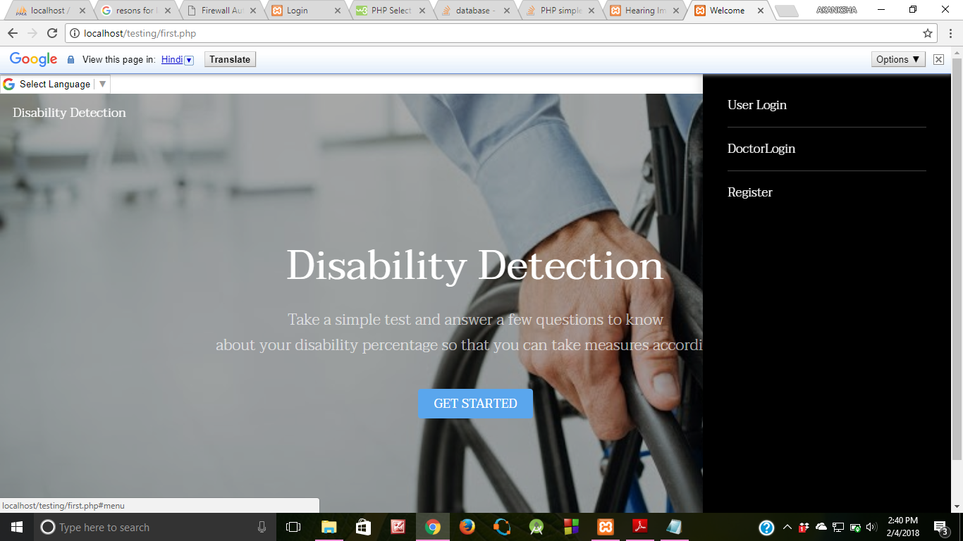

Slide 12
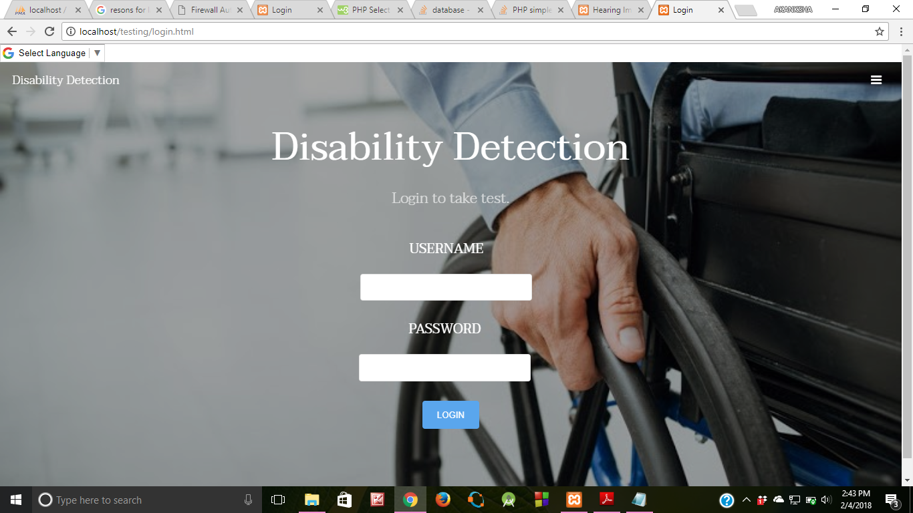

Slide 13
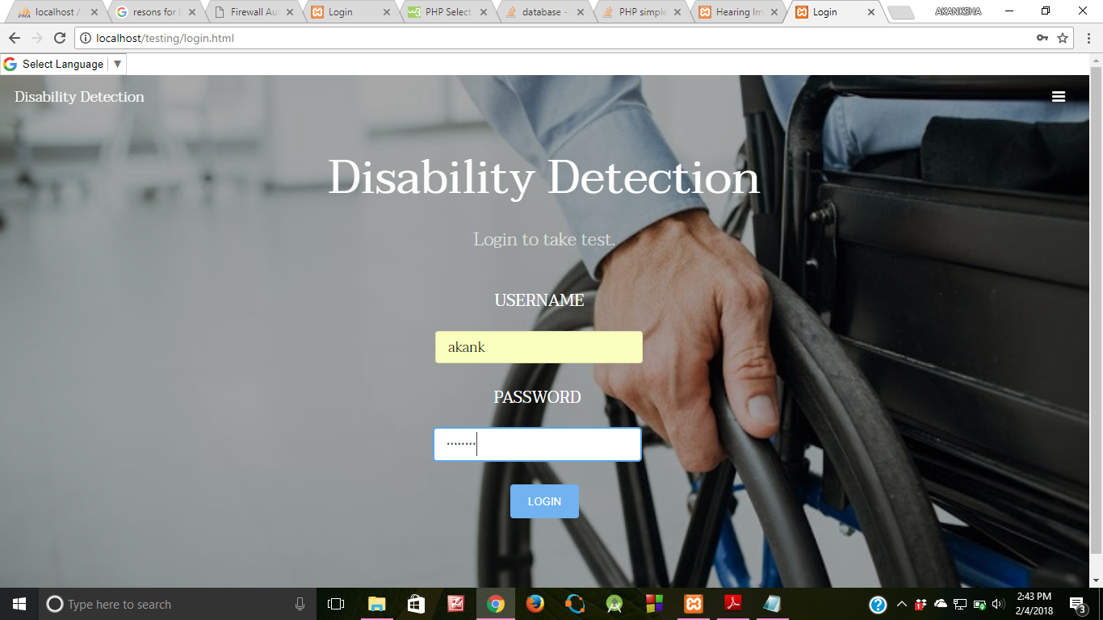

Slide 14
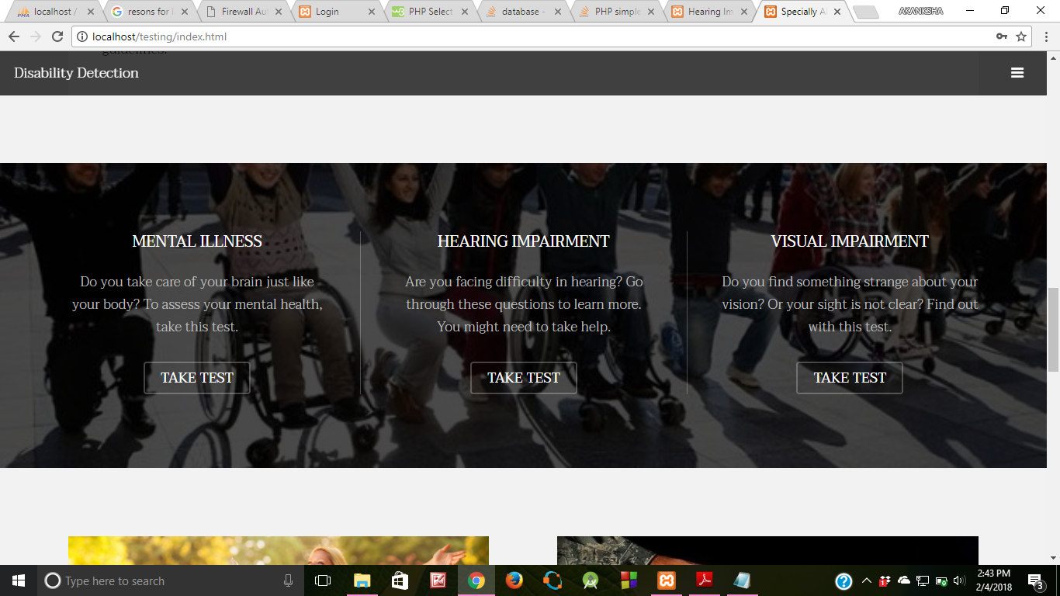

Slide 15
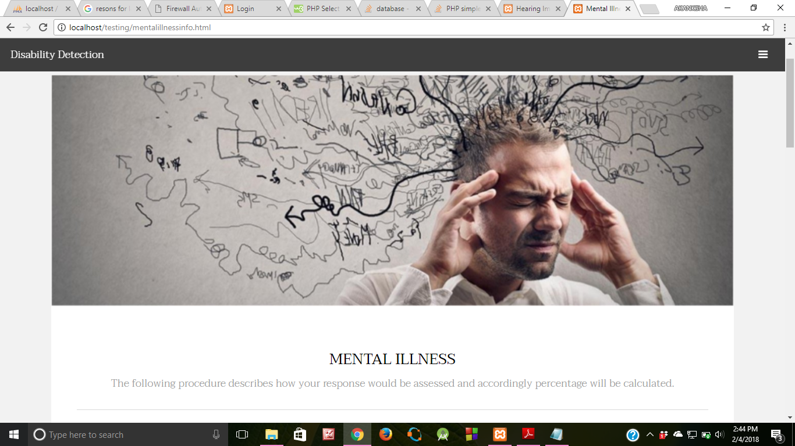

Slide 16
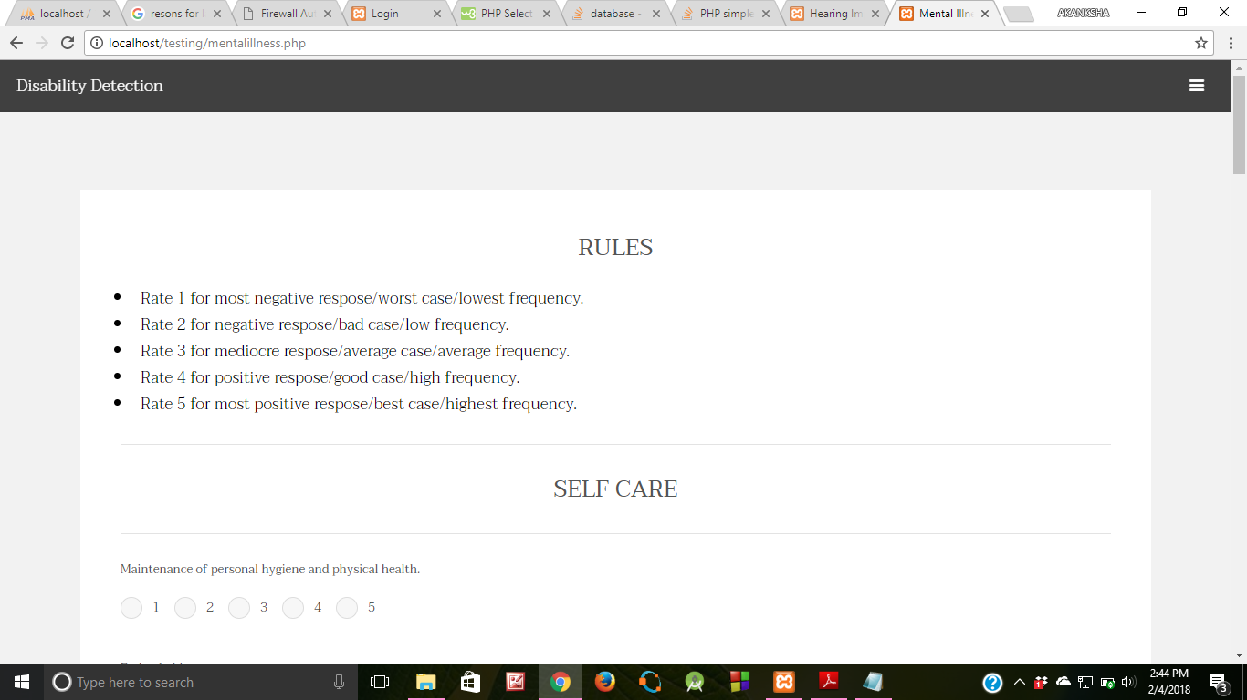

Slide 17
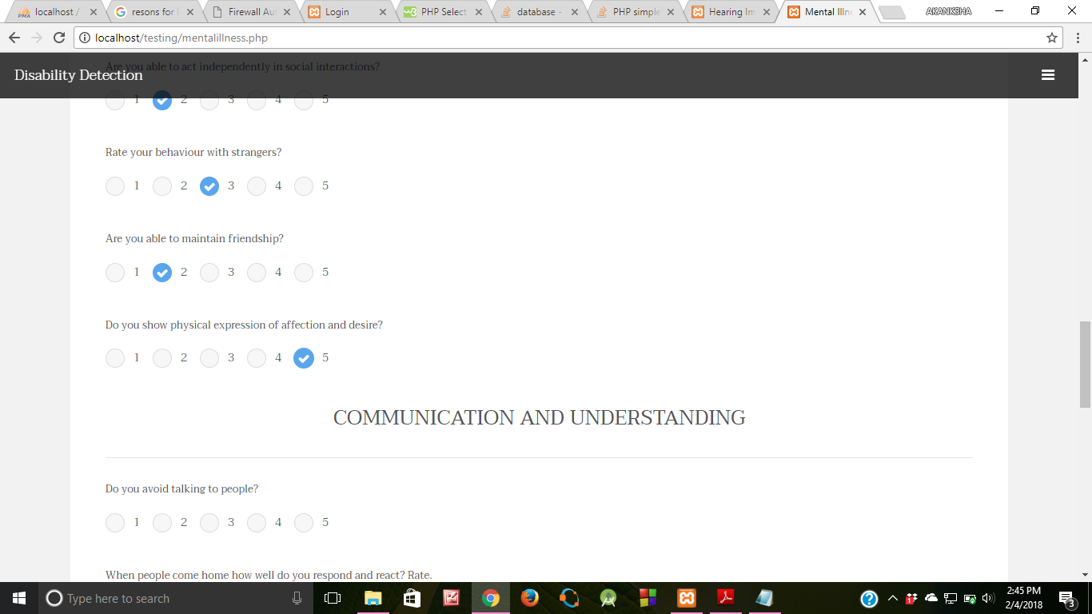

Slide 18
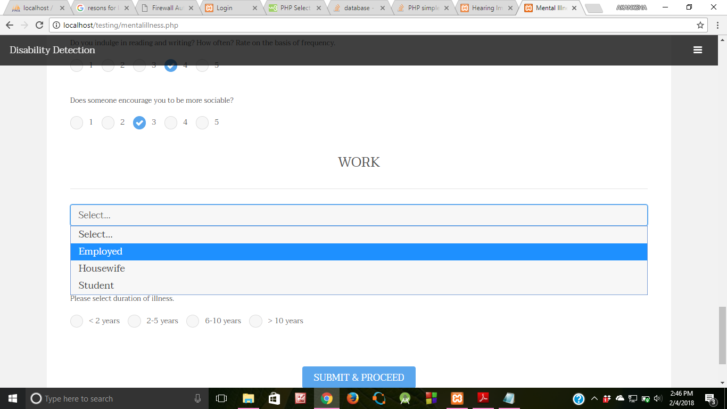

Slide 19
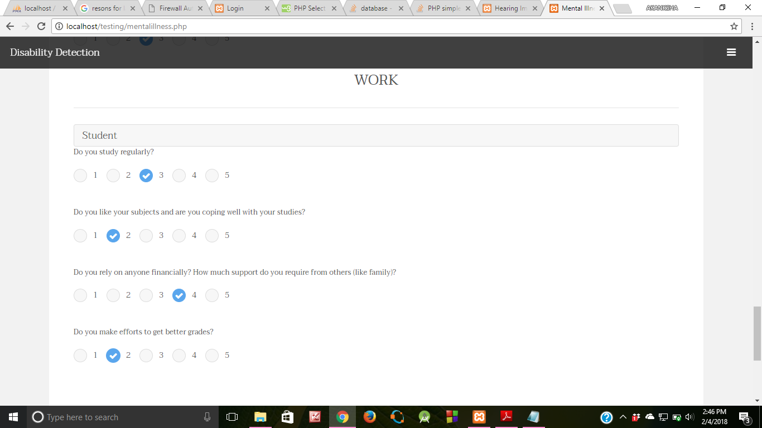

Slide 20
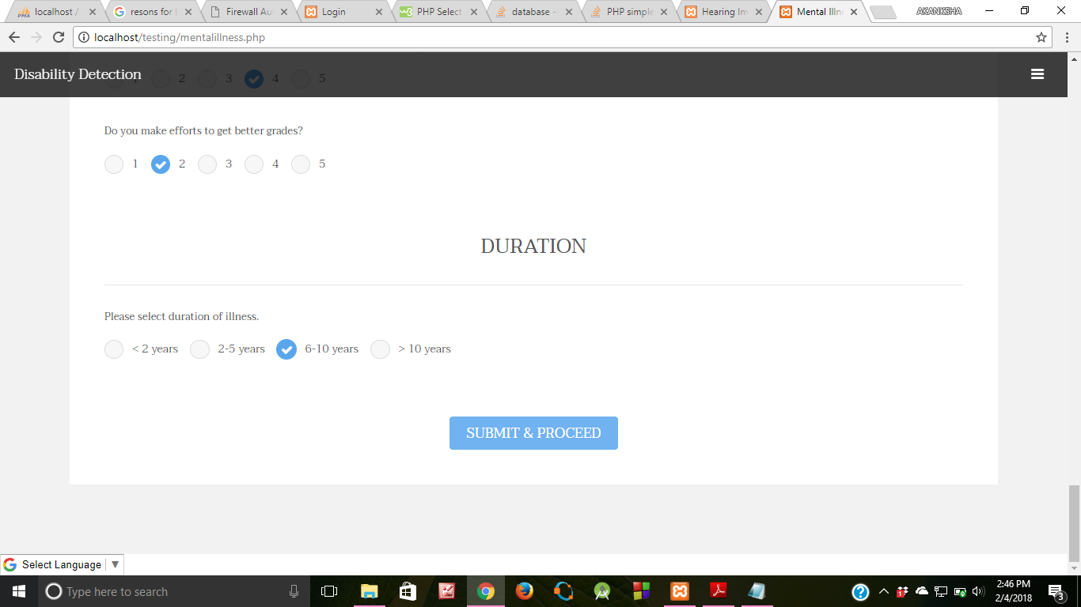

Slide 21
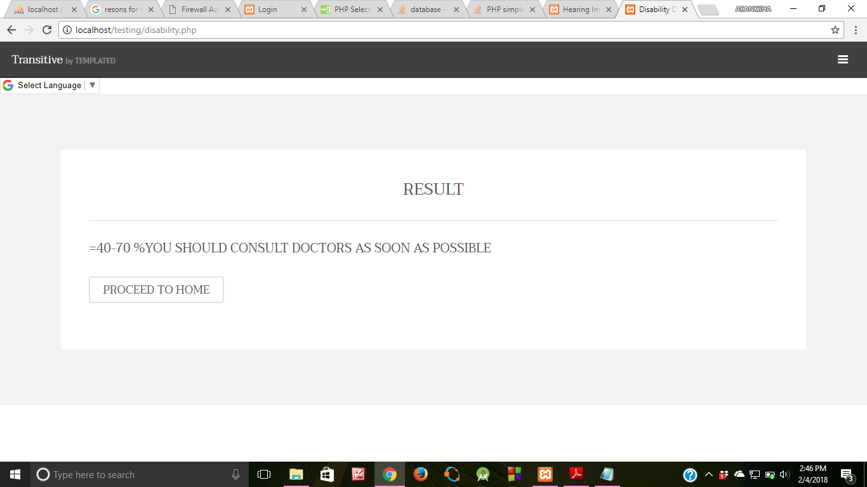

Slide 22
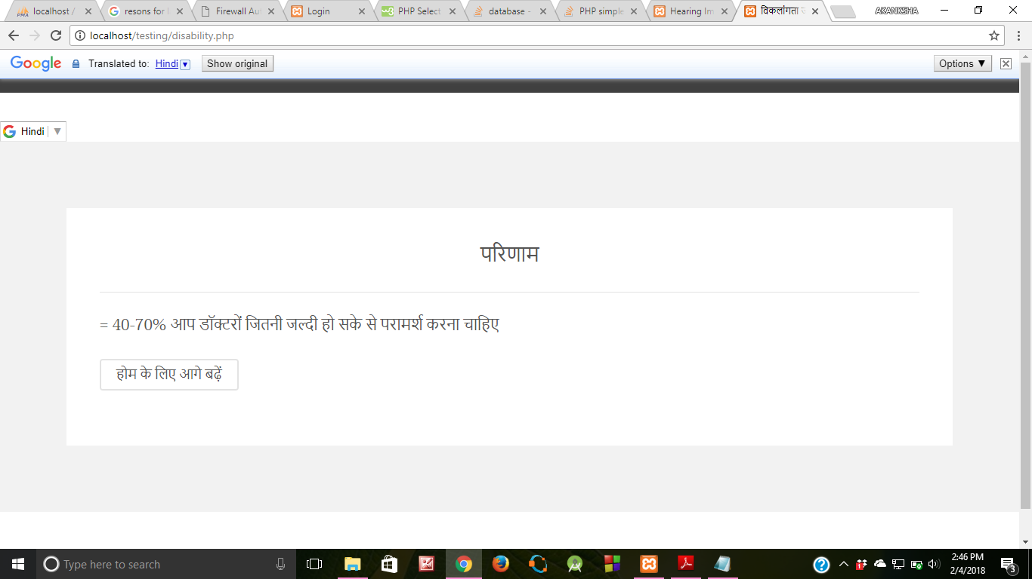

Slide 23
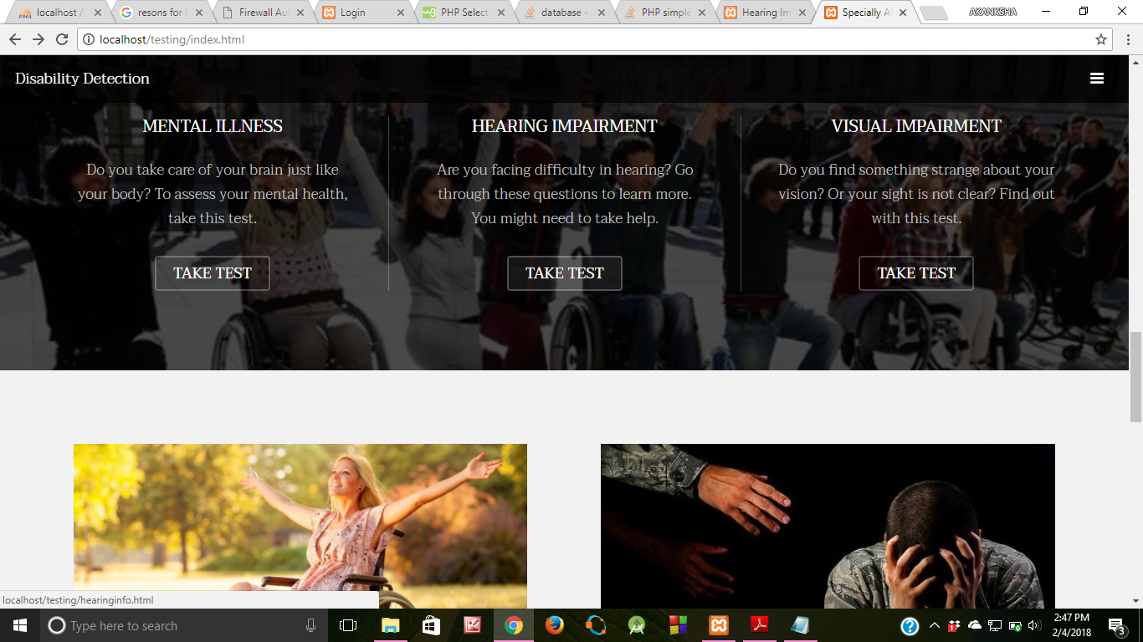

Slide 24
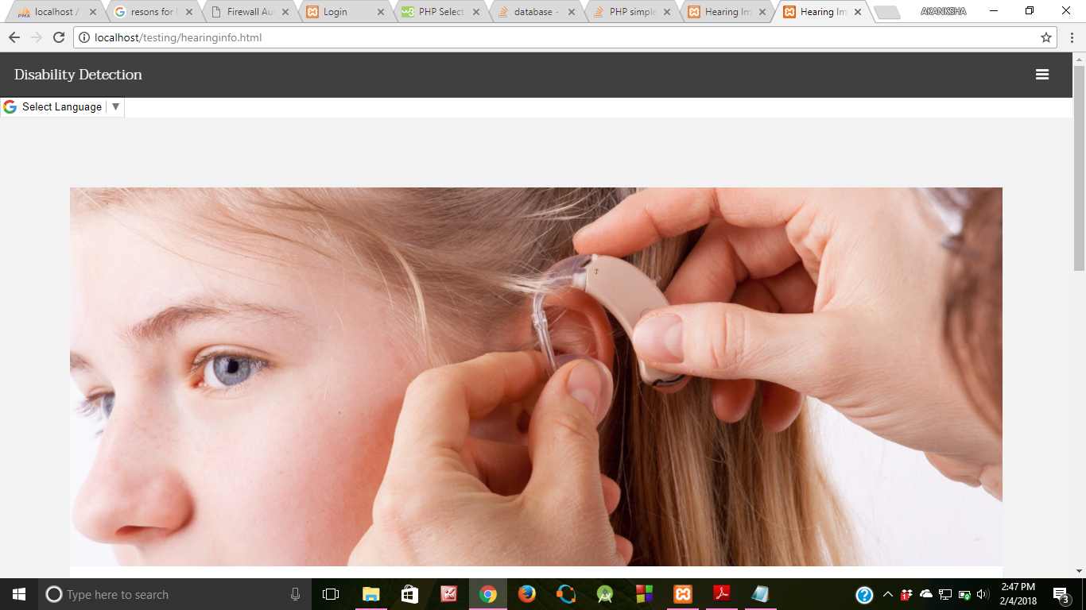

Slide 25
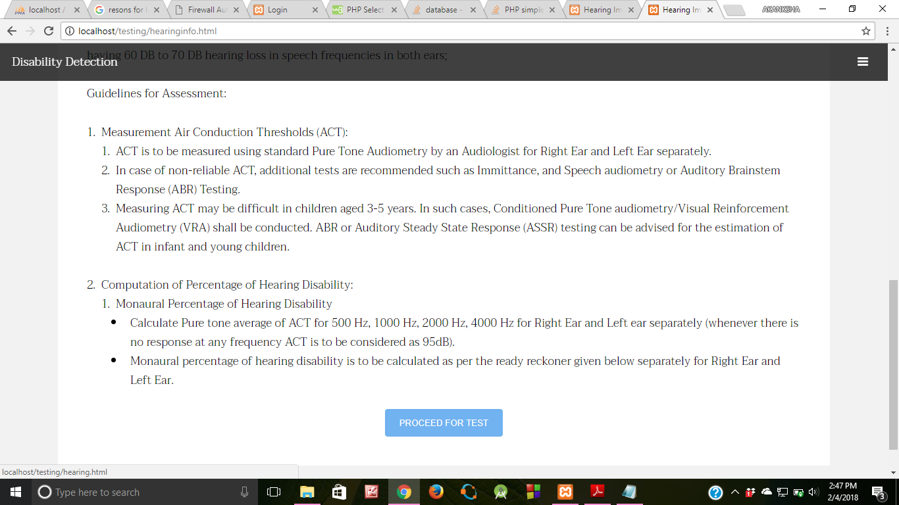

Slide 26
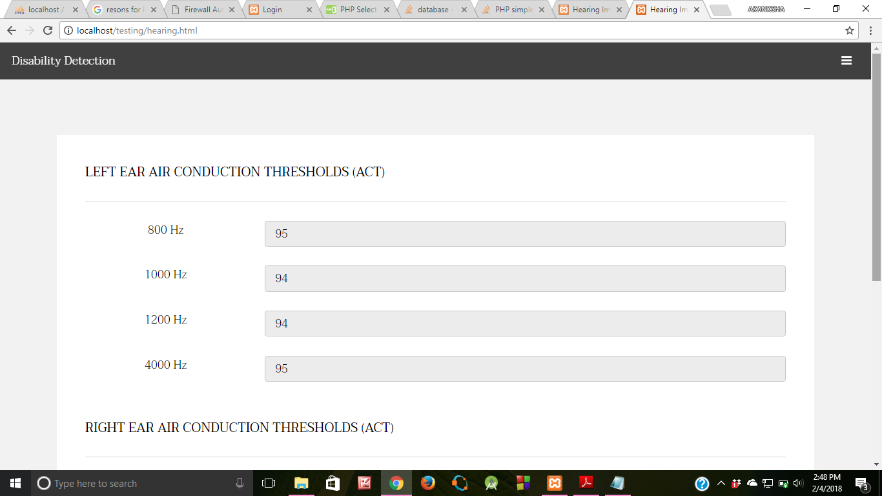

Slide 27
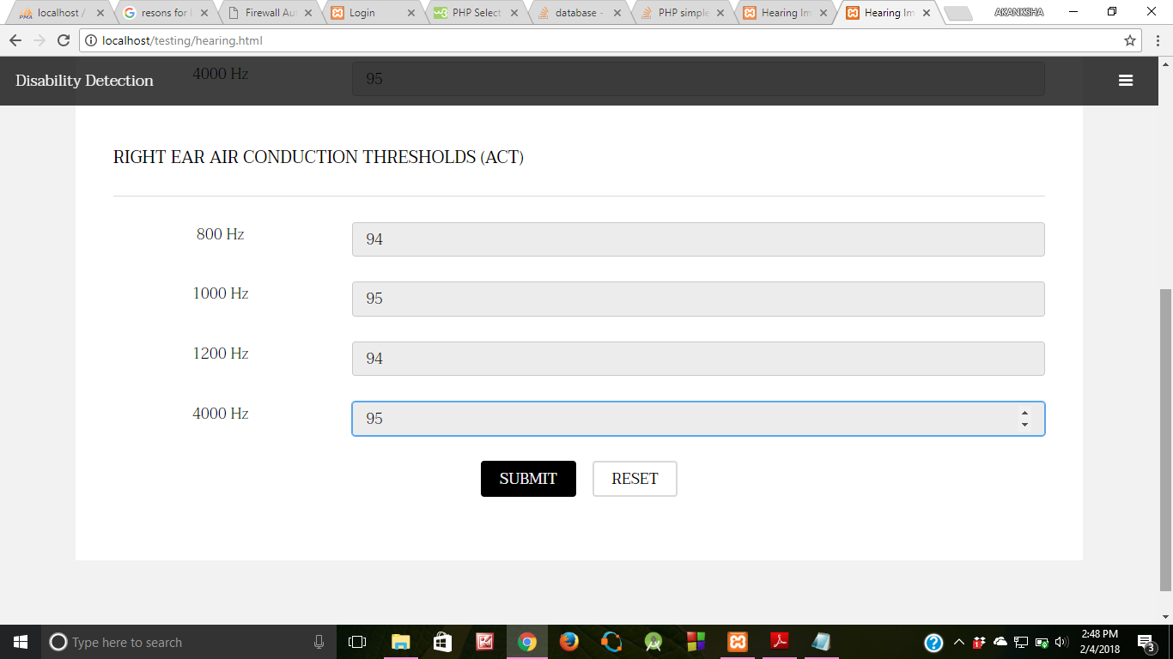

Slide 28
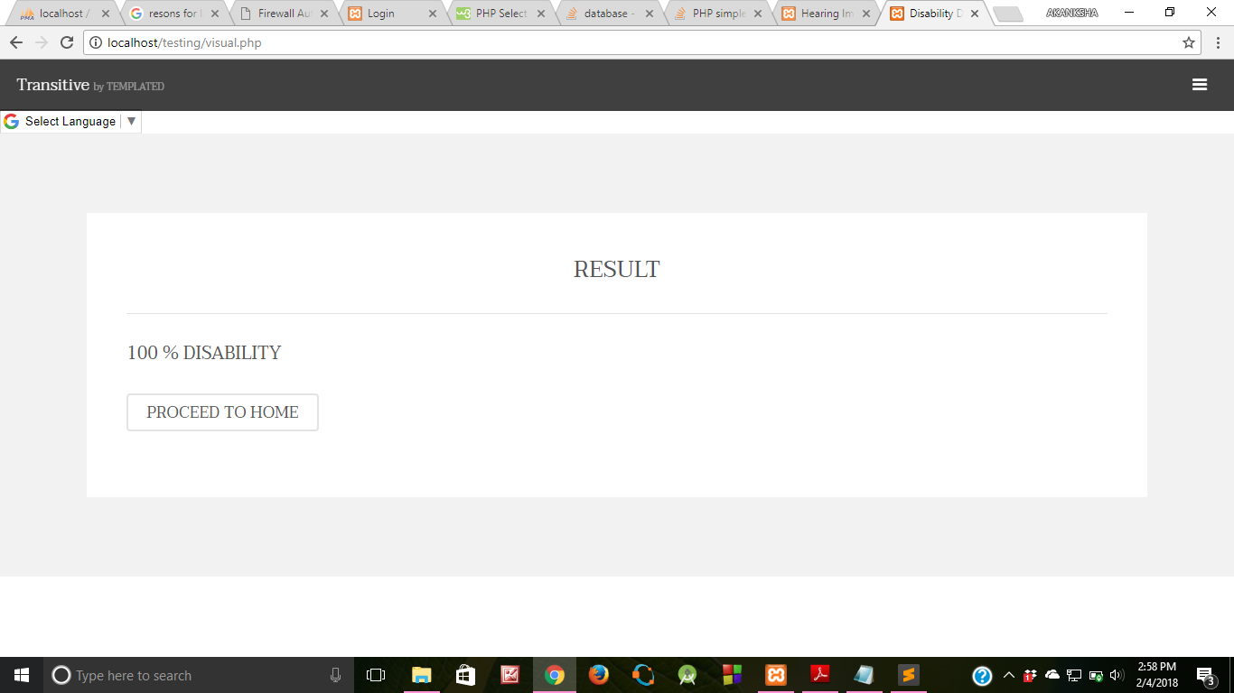

Slide 29
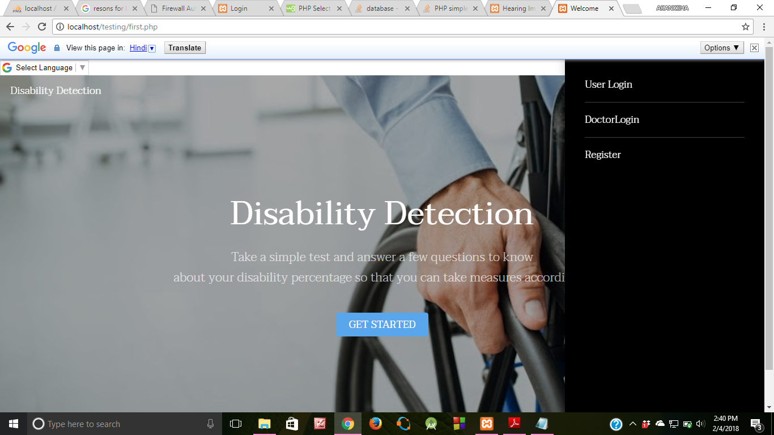

Slide 30
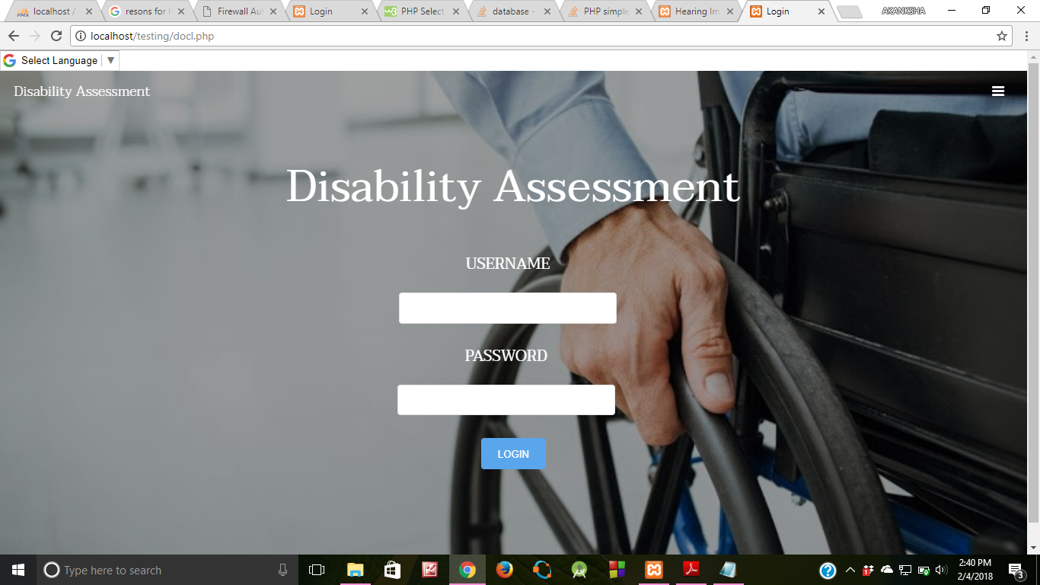

Slide 31
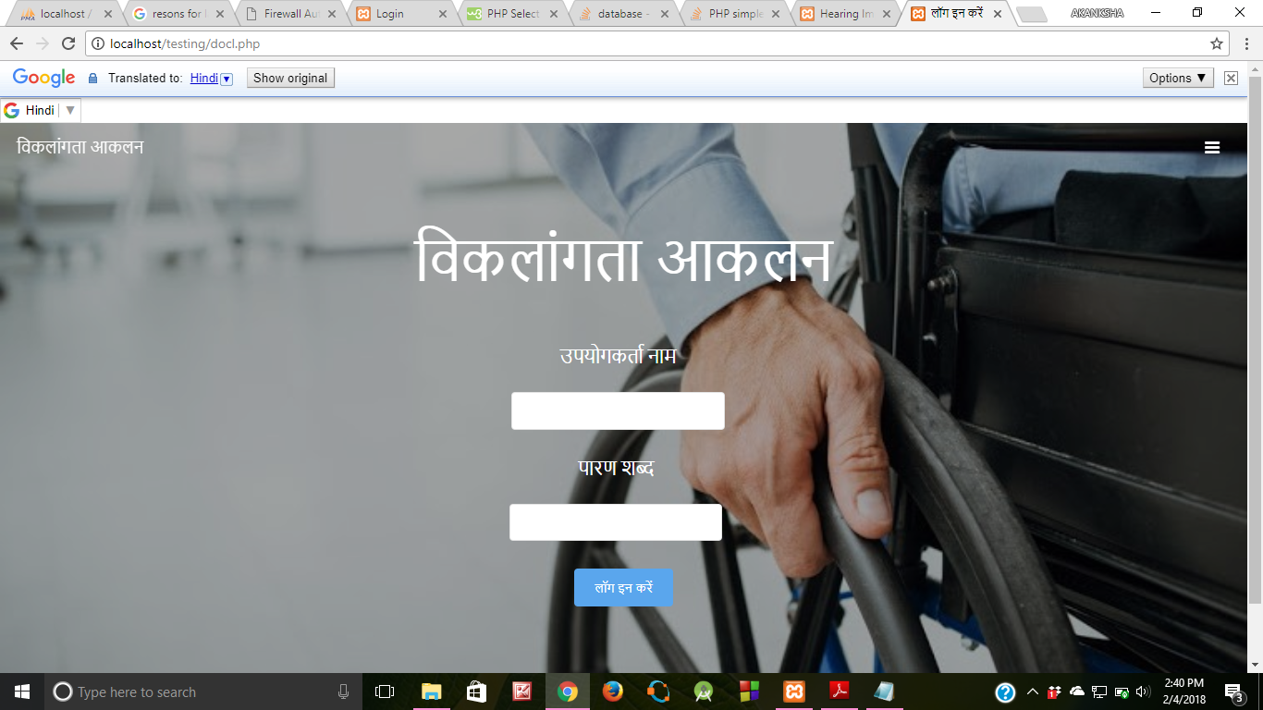

Slide 32
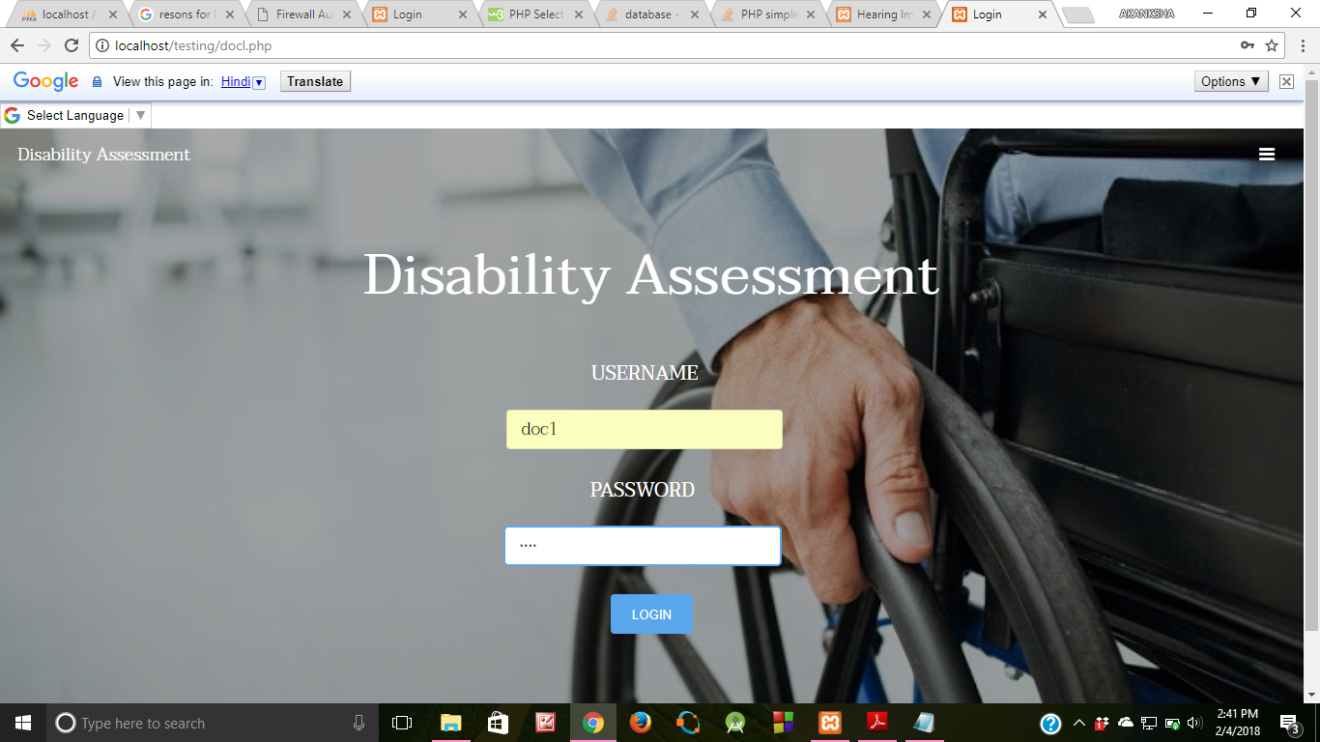

Slide 33
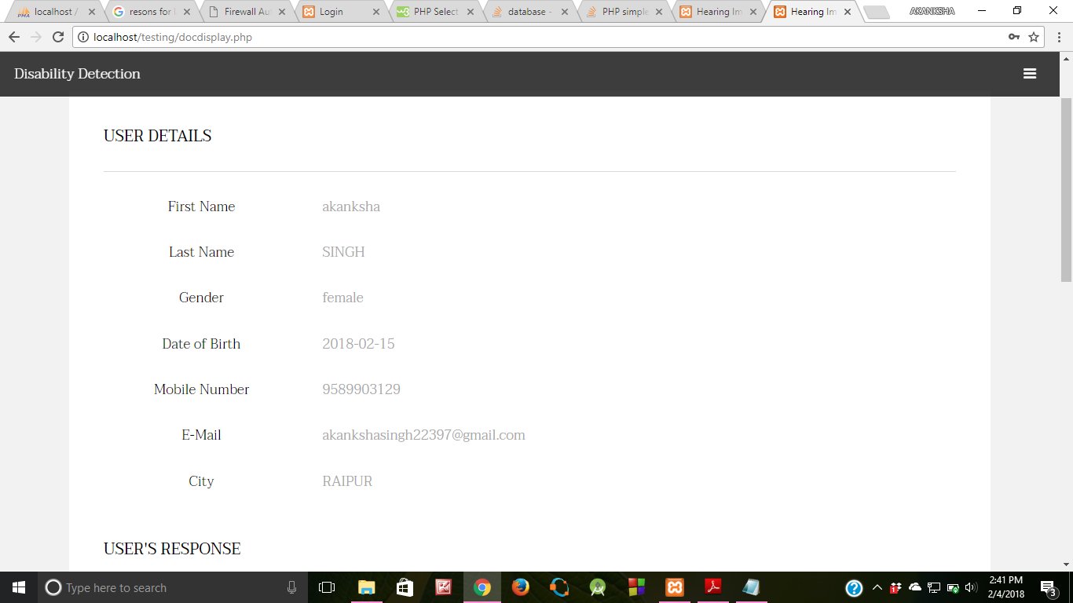

Slide 34
